Slide 1
photo booth for rent near Culver City
https://www.luckyfrogphotos.com/culvercityphotobooth.html
Notes:
https://www.luckyfrogphotos.com/culvercityphotobooth.html
https://drive.google.com/drive/folders/1lyiOePmQLgeyp8L6GdD53kTXSfhwGDrQ?usp=sharing
https://news.google.com/rss/search?q=videobooth
https://drive.google.com/drive/folders/1geM8RYRnhwgJXe-CE3Npcvh9VaYgm5Od?usp=sharing
https://drive.google.com/drive/folders/1ya2t5ipCWpZR0d7WuhvAXD4PAEQtxTe8?usp=sharing
https://drive.google.com/drive/folders/1rdu_imHfaUviSq7v142itVanHN3XRpLg?usp=sharing
https://drive.google.com/drive/folders/17Q6psrg0u_iJ9RzIJNzokB-ITp_LMzeO?usp=sharing
https://drive.google.com/file/d/1t33hvFbsi4sSFSNdR8g74m5ACVKQUi0g/view?usp=sharing
https://drive.google.com/file/d/1-bgEB03du93MjzZ1U_bkiROzwf4JmDmk/view?usp=sharing
https://docs.google.com/spreadsheets/d/1i-GQ5B8JUqhJaXgaPVdbBHSAxxKrbk3yuCfWg0-qL0c/edit?usp=sharing
https://docs.google.com/spreadsheet/pub?key=1i-GQ5B8JUqhJaXgaPVdbBHSAxxKrbk3yuCfWg0-qL0c
https://docs.google.com/spreadsheets/d/1i-GQ5B8JUqhJaXgaPVdbBHSAxxKrbk3yuCfWg0-qL0c/pubhtml
https://docs.google.com/spreadsheets/d/1i-GQ5B8JUqhJaXgaPVdbBHSAxxKrbk3yuCfWg0-qL0c/pub
https://docs.google.com/spreadsheets/d/1i-GQ5B8JUqhJaXgaPVdbBHSAxxKrbk3yuCfWg0-qL0c/view
https://docs.google.com/forms/d/12lC8VLRgGsp9pGbbDtKurCpjmET84K2MmjcOL_o0sCw/edit?usp=sharing
https://docs.google.com/drawings/d/136PzSLEZPzzaYxRiiDX6zTzw8cCXf3wsW5C8GgJVIzo/edit?usp=sharing
https://drive.google.com/file/d/1Ub_baxN1yIKa7z6PHbWKiQ5Hv3QmkYdb/view?usp=drivesdk
https://sites.google.com/view/culvercityphotoboothrentals/home
https://docs.google.com/document/d/1rATw9R_Gx7NLNbNO8UdL10iAADSTjCQNgPxW8B-Z7_A/edit?usp=sharing
https://docs.google.com/document/d/1rATw9R_Gx7NLNbNO8UdL10iAADSTjCQNgPxW8B-Z7_A/pub
https://docs.google.com/document/d/1rATw9R_Gx7NLNbNO8UdL10iAADSTjCQNgPxW8B-Z7_A/view
https://docs.google.com/presentation/d/1ARse9m3U75KwkzekT1PjyAHsSK-6HSkNEI8N0xtayJQ/edit?usp=sharing
https://docs.google.com/presentation/d/1ARse9m3U75KwkzekT1PjyAHsSK-6HSkNEI8N0xtayJQ/pub?start=true&loop=true&delayms=3000
https://docs.google.com/presentation/d/1ARse9m3U75KwkzekT1PjyAHsSK-6HSkNEI8N0xtayJQ/view
https://docs.google.com/presentation/d/1ARse9m3U75KwkzekT1PjyAHsSK-6HSkNEI8N0xtayJQ/htmlpresent

Slide 2
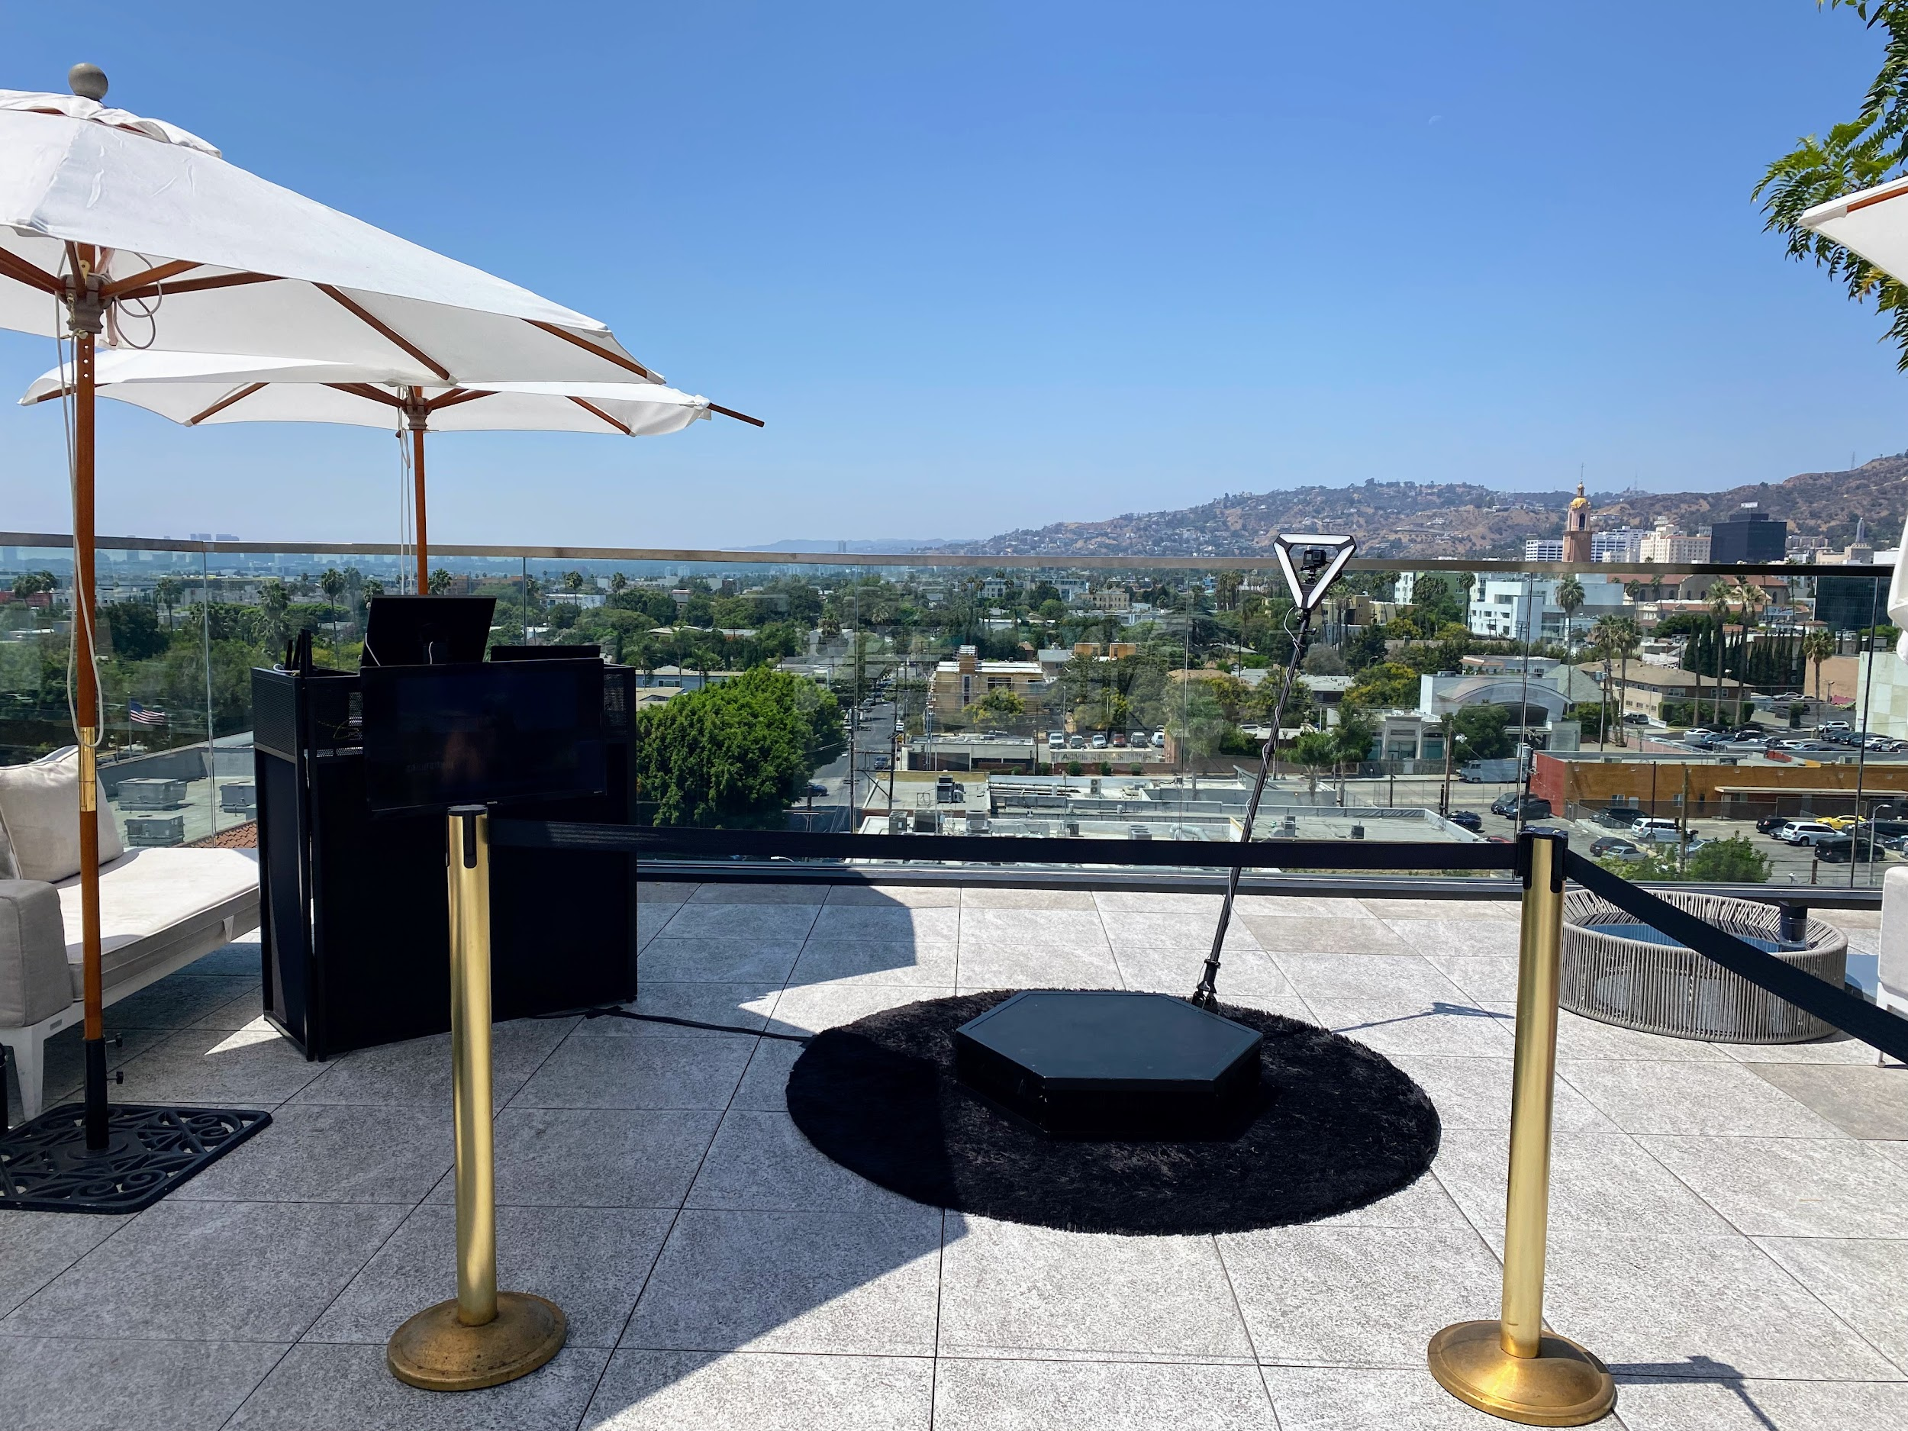

Slide 3


Slide 4
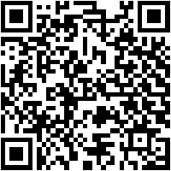
photo booth for rent near Culver City
Just once Dining out, not all 360 video booth rentals close San Gabriel are similar. bearing in mind our best environment photo booth services, we hand crafted the best mood spinner platform and slow motion video gear to make positive your slomo Videos are the best in al of San Gabriel and the 626 area. Our way in expose Photo Booths, Selfie Stations, Video booths and 360 Photo Booths are essentially one of a kind, and are crafted using unaided the best materials in relation to Los Angeles. Unlike the lower air made in China booths that are a dime a dozen, our unique booths are handcrafted, professionally made and will look wonderful at your adjacent situation in this area San Gabriel. Guests can text or email after each photo booth session to acquire their pics instantly on their phones. Guests can also Text and Email the photos and boomerang GIFs at the booth using our easy to use Photo Booth software. We lonely use the best setting multimedia equipment that offers the best for actions in Los Angeles and present High-end behind social media integration and {} we are a photo entertainment company that specializes in studio lighting techniques. Our photo booth Pictures are the highest tone in Los Angeles and every of yellow County, are in focus and sure taking into account proper studio lighting. We afterward find the money for the unconditionally best in unique or custom options to customize the print designs using your brand, logo and theme. We have a big selection of backdrops that are some of the finest available, and will provide a great and fun showing off to make smile for any occasion Our 360 booths are a good ice breaker for guests here in the San Gabriel Valley, and we have a bunch of alternative looks to match your 626 event. Also, the customer foster experience we manage to pay for guaranteed to create your corporate event, wedding or new occasion unforgettable, and to keep the photo booth fun for you and your guests. Lastly, even if creating lasting memories, we will make distinct youll get lab-quality photos from the way in ventilate photo booth. You have a huge number of possibilities for your neighboring photo booth rentals here in San Gabriel, and is a perfect fit for any event type. Our Photo booths make a customized experience for any event,and Best Photo Booths Fun For every Ages and we praise Winning service that is unmatched. The environment of the photo kiosk is super important; after all, you dont desire an unprofessional-looking photo booth at your bordering event! We torment yourself to provide our customers a astounding photo experience and we are Southern California's premier special situation photo booth company, lucky Frog Photo Booth is the Los Angeles and orange County area's premier photo booth rental company that is tailor-made for immersion and photo entertainment. Each thing has its lasting memories, and we will make sure whatever gets custom tailored to your situation needs. Our 360 Photo Booth is very unique and handcrafted in the USA, and will amass on a unique adjunct to just practically any event: We will be happy to wander you through the booking process, we will go as far away as humanly doable to create your concern happen.
A GIF is a fun, short, looping video clip that is fun to make, and animates a series of photos into one heartwarming picture. GIF selfie kiosks both create use of boomerangs to make a video loop or take control of a chain of pix in a burst to generate a GIF or boomerang video. {} {} Photo kiosks will permit more associations afterward your celebration visitors and make a sharable video that everybody can enjoy instantly. Slow-mo changes whatever in the video, appropriately even a small pastime can look super cool. considering many supplementary technologies, a slo mo video was back reserved lonely for film studios, however it has now made its artifice to a photo booth rental. {} {} Relive captured issue videos together along once your friends or proclaim the videos online for every your cronies to enjoy.Choose the maximum pleasing place on your video booth setup; usually something like 15 ft x 15 ft works great. {} Your video booth setup needs to be located like no obstructions in its area. Our 360 photo booth rental is more than just a standard read freshen photo booth; It will present a unique video experience and allow you to capture your situation in a collective extra way. {} Many difficult businesses have rented our 360 photo booths to easily create video content at their events. {} {} {}&nbsp;Regardless of the business type, the 360 video booth gives a one-of-a-kind experience for any event; Thanksgiving Parties, Office get-togethers, Corporate Functions, family Christmas parties, Company Parties, Holiday Events, Santa Celebrations, Hanukkah Parties just to name a few. {} Your take aim should be to offer matter guests an experience they can easily ration and renting a 360 photo booth foster is one of the most fun ways for you to level going on any event. In the age of Tiktock and stories, video content is taking beyond social media, next lots more captivation coming from a video state vs photos. later than many ocher County event planners these days, you may be wondering how to capture a sharp video at your event for attendees to part instantly. After play some research, you may have realized that hiring a professional video team is too costly and the production mature takes weeks if not months to develop quality video content. Using big video lights, production equipment, and the production team that runs them can be no question intimidating to the participants who are not used to subconscious in belly of a professional camera. Our Viral Video Photo Booth is the ideal answer for yellowish-brown County matter planners who craving to create fascinating user-generated videos for social media and produce them in real time. Social Media is every virtually play a role things fast, and lets slant it, not everyone is a wiz at creating branded videos similar to their phones. Our Viral Video Photo Booth is the ideal method that provides a convenient habit to instantly take possession of buzz-worthy video clips at matter events, weddings, and parties. Videos are currently the top-ranking content on social media platforms because they save people engaged longer than new types of content such as photos of food or their pets. People adore to watch videos upon their phones upon social media platforms such as TikTok, Instagram Reels, YouTube shorts, and Facebook Stories just to post a few. As a result, social media algorithms are much more likely to rank your videos toward the top, giving you more opportunities to announce your brand or seize a larger audience. {} A video photo booth will keep busy your guest in the same way as vibes party entertainment and have enough money them the opportunity to portion well-ventilated extra content as soon as your company branding. {} Our viral video photo booth allows you to engage as soon as your guests in a entire sum supplementary quirk by capturing videos using fun and interactive kiosks at your concern rather than a large video production crew. Our viral video photo booth provides a unique video experience that can be set occurring at exchange types of actions including your next: Birthday Party, Brand Activation, OC Corporate Event, orange County Red carpet Gala, Wedding, Baby Shower, Wedding Anniversary, captivation Party or OC Bridal Shower.
https://www.luckyfrogphotos.com/culvercityphotobooth.html
Notes:
photo booth for rent near Culver City

Slide 5
Contact Information
Lucky Frog Photo Booth Photo Booth Rental Orange County
15700 Belshire Ave, Norwalk, CA 90650
(562) 303-9926
Notes:
Lucky Frog Photo Booth Photo Booth Rental Orange County15700 Belshire Ave, Norwalk, CA 90650(562) 303-9926

Slide 6
More info about us:
photo booth for rent near Culver City
Notes:
Lucky Frog Photo Booth Photo Booth Rental Orange County15700 Belshire Ave, Norwalk, CA 90650(562) 303-9926

Slide 7
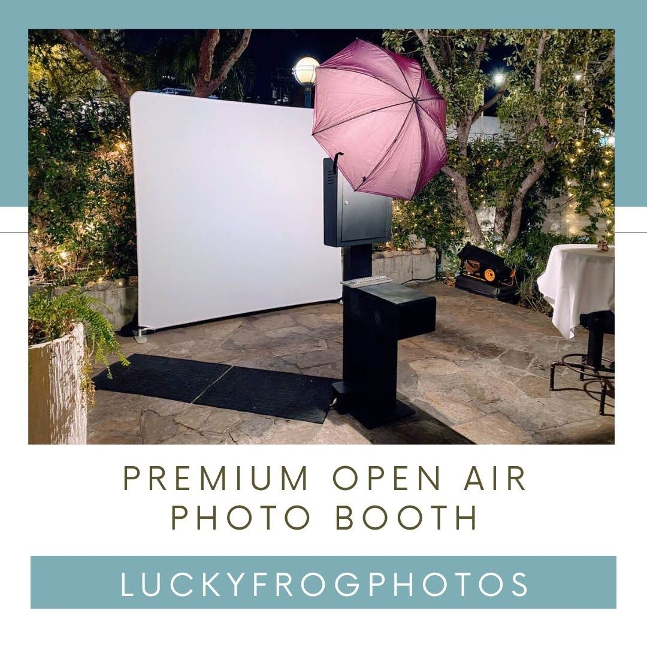

Slide 8
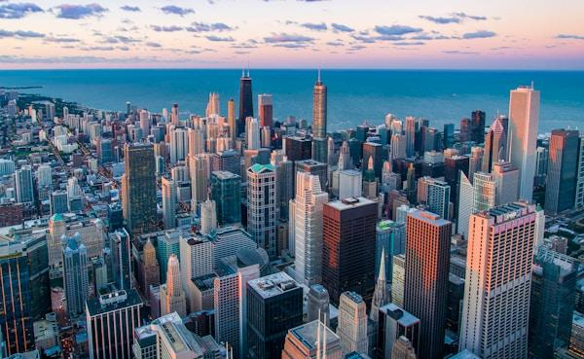

Slide 9
Links
List of recommended resources
Notes:
photo booth for rent near Culver City

Slide 10
Please visit :
target url
folder top
rss feed
folder articles
folder photos
folder pdfs
folder slides
photo
photo
spreadsheet
spreadsheet key
spreadsheet pubhtml
spreadsheet pub
spreadsheet view
form
drawing
image
image link
document
document pub
document view
presentation
presentation pub
presentation view
presentation html

Slide 11
Videos
YouTube videos we recommend watching!
Notes:
photo booth for rent near Culver City

Slide 12
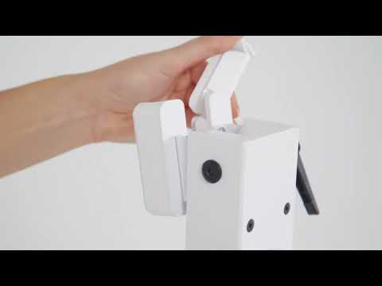
https://www.luckyfrogphotos.com/culvercityphotobooth.html

Slide 13
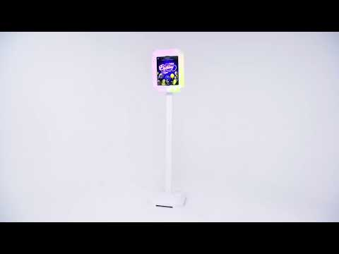
https://www.luckyfrogphotos.com/culvercityphotobooth.html

Slide 14
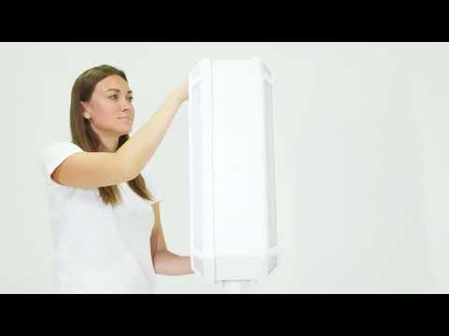
https://www.luckyfrogphotos.com/culvercityphotobooth.html

Slide 15
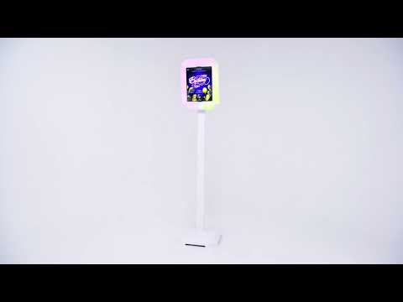
https://www.luckyfrogphotos.com/culvercityphotobooth.html

Slide 16
https://www.luckyfrogphotos.com/culvercityphotobooth.html
Notes:
https://www.luckyfrogphotos.com/culvercityphotobooth.html
https://drive.google.com/drive/folders/1lyiOePmQLgeyp8L6GdD53kTXSfhwGDrQ?usp=sharing
https://news.google.com/rss/search?q=videobooth
https://drive.google.com/drive/folders/1geM8RYRnhwgJXe-CE3Npcvh9VaYgm5Od?usp=sharing
https://drive.google.com/drive/folders/1ya2t5ipCWpZR0d7WuhvAXD4PAEQtxTe8?usp=sharing
https://drive.google.com/drive/folders/1rdu_imHfaUviSq7v142itVanHN3XRpLg?usp=sharing
https://drive.google.com/drive/folders/17Q6psrg0u_iJ9RzIJNzokB-ITp_LMzeO?usp=sharing
https://drive.google.com/file/d/1t33hvFbsi4sSFSNdR8g74m5ACVKQUi0g/view?usp=sharing
https://drive.google.com/file/d/1-bgEB03du93MjzZ1U_bkiROzwf4JmDmk/view?usp=sharing
https://docs.google.com/spreadsheets/d/1i-GQ5B8JUqhJaXgaPVdbBHSAxxKrbk3yuCfWg0-qL0c/edit?usp=sharing
https://docs.google.com/spreadsheet/pub?key=1i-GQ5B8JUqhJaXgaPVdbBHSAxxKrbk3yuCfWg0-qL0c
https://docs.google.com/spreadsheets/d/1i-GQ5B8JUqhJaXgaPVdbBHSAxxKrbk3yuCfWg0-qL0c/pubhtml
https://docs.google.com/spreadsheets/d/1i-GQ5B8JUqhJaXgaPVdbBHSAxxKrbk3yuCfWg0-qL0c/pub
https://docs.google.com/spreadsheets/d/1i-GQ5B8JUqhJaXgaPVdbBHSAxxKrbk3yuCfWg0-qL0c/view
https://docs.google.com/forms/d/12lC8VLRgGsp9pGbbDtKurCpjmET84K2MmjcOL_o0sCw/edit?usp=sharing
https://docs.google.com/drawings/d/136PzSLEZPzzaYxRiiDX6zTzw8cCXf3wsW5C8GgJVIzo/edit?usp=sharing
https://drive.google.com/file/d/1Ub_baxN1yIKa7z6PHbWKiQ5Hv3QmkYdb/view?usp=drivesdk
https://sites.google.com/view/culvercityphotoboothrentals/home
https://docs.google.com/document/d/1rATw9R_Gx7NLNbNO8UdL10iAADSTjCQNgPxW8B-Z7_A/edit?usp=sharing
https://docs.google.com/document/d/1rATw9R_Gx7NLNbNO8UdL10iAADSTjCQNgPxW8B-Z7_A/pub
https://docs.google.com/document/d/1rATw9R_Gx7NLNbNO8UdL10iAADSTjCQNgPxW8B-Z7_A/view
https://docs.google.com/presentation/d/1ARse9m3U75KwkzekT1PjyAHsSK-6HSkNEI8N0xtayJQ/edit?usp=sharing
https://docs.google.com/presentation/d/1ARse9m3U75KwkzekT1PjyAHsSK-6HSkNEI8N0xtayJQ/pub?start=true&loop=true&delayms=3000
https://docs.google.com/presentation/d/1ARse9m3U75KwkzekT1PjyAHsSK-6HSkNEI8N0xtayJQ/view
https://docs.google.com/presentation/d/1ARse9m3U75KwkzekT1PjyAHsSK-6HSkNEI8N0xtayJQ/htmlpresent

Slide 17
photo booth for rent near Culver City
https://www.luckyfrogphotos.com/culvercityphotobooth.html
Notes:
photo booth for rent near Culver City

